Slide 1
EAT, COOK, REPEAT
Bagus Dzikri Hidayat
BZ7830

Slide 2
Goals
Completing the API task in PijarCamp scholarship
Designing and developing the backend for Eat, Cook, Repeat recipe application
Designing the social media platform for all cooks to share all their recipes to everyone

Slide 3
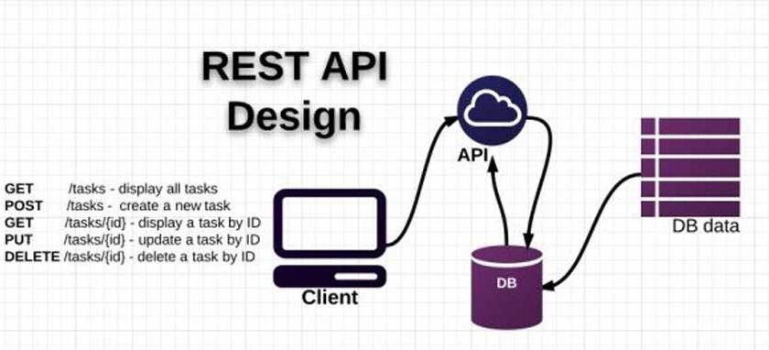


Tech Stack

Slide 4
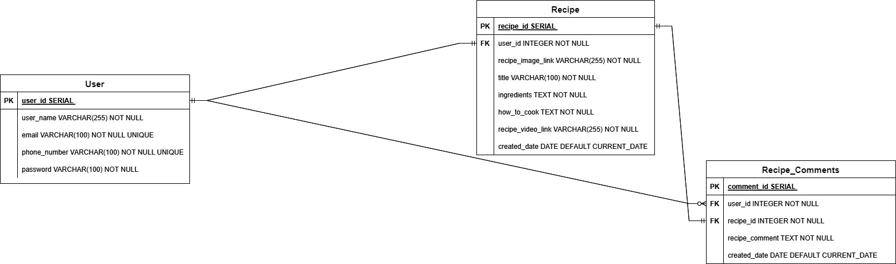
Entity Relational Diagram

Slide 5
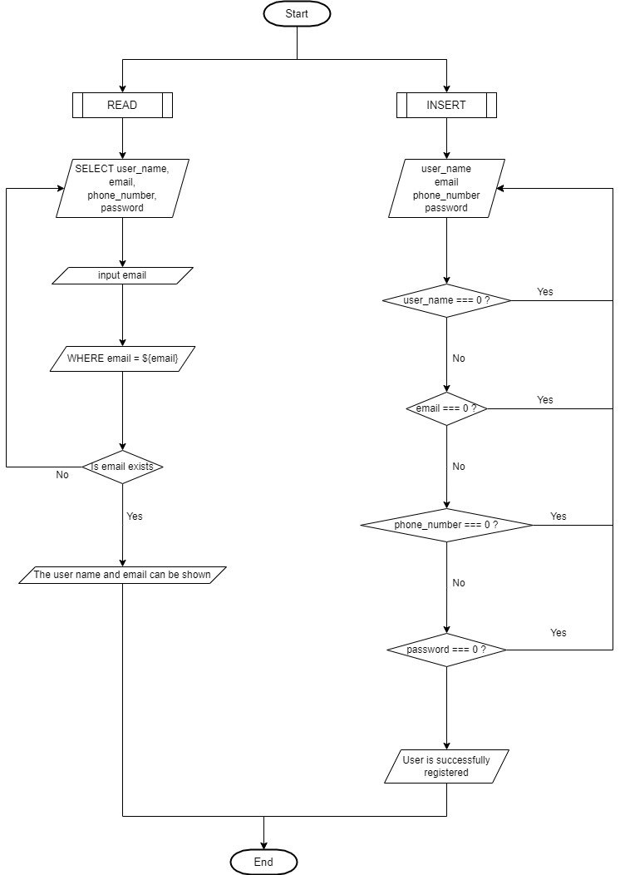
User CRUD Flowchart

Slide 6
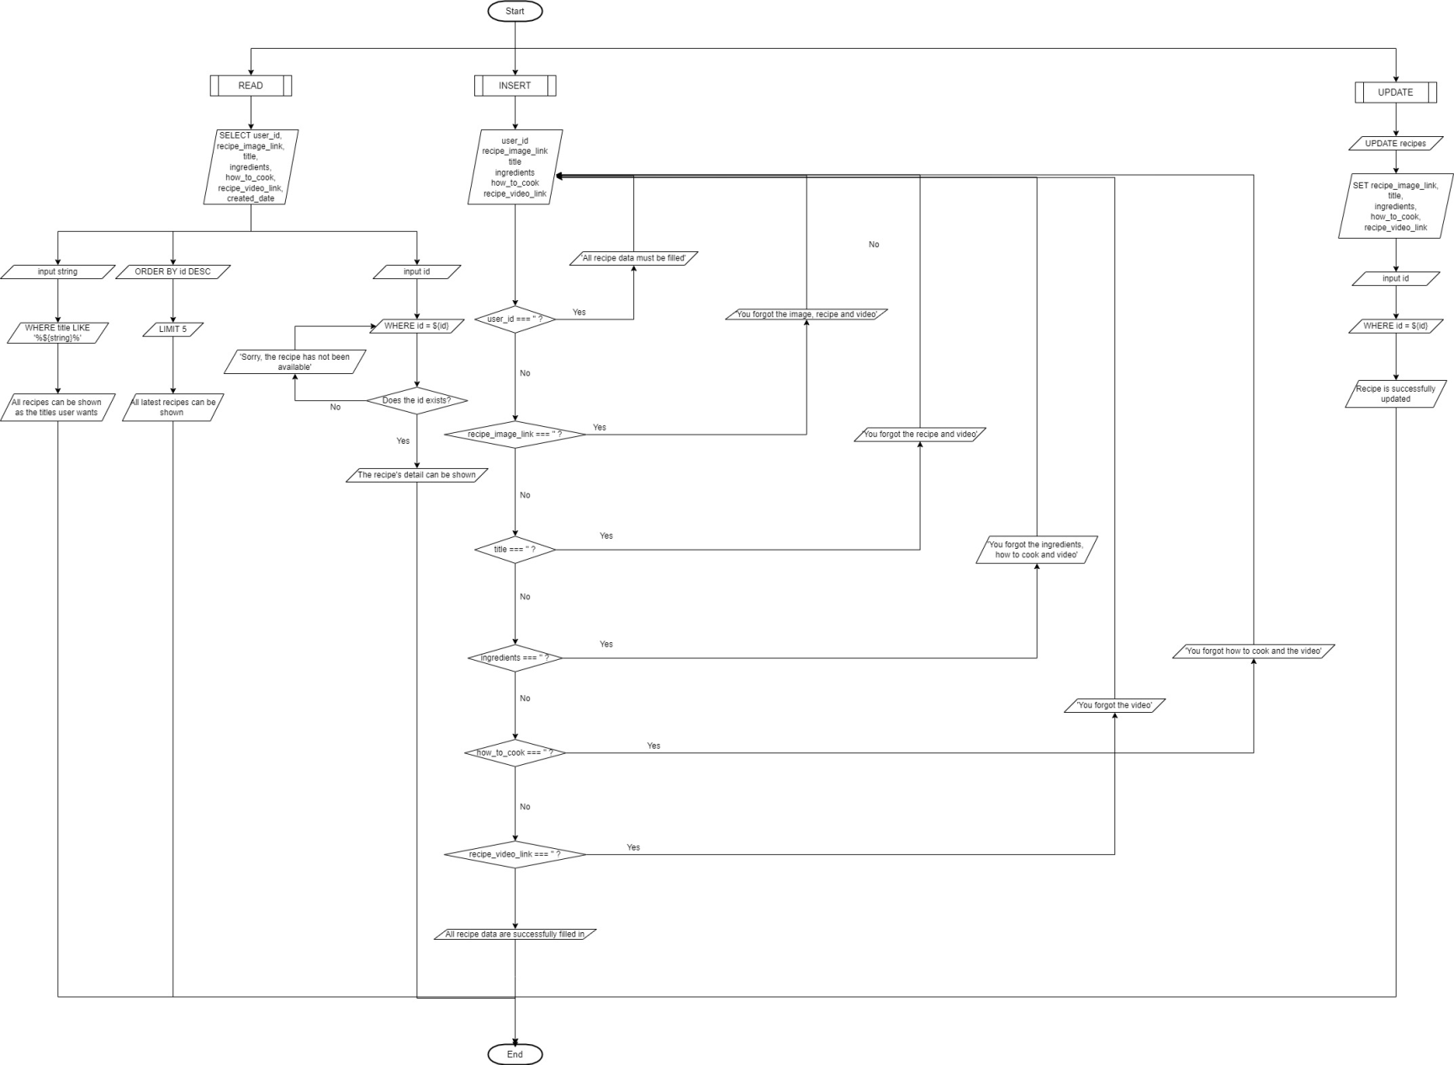
Recipe CRUD Flowchart

Slide 7
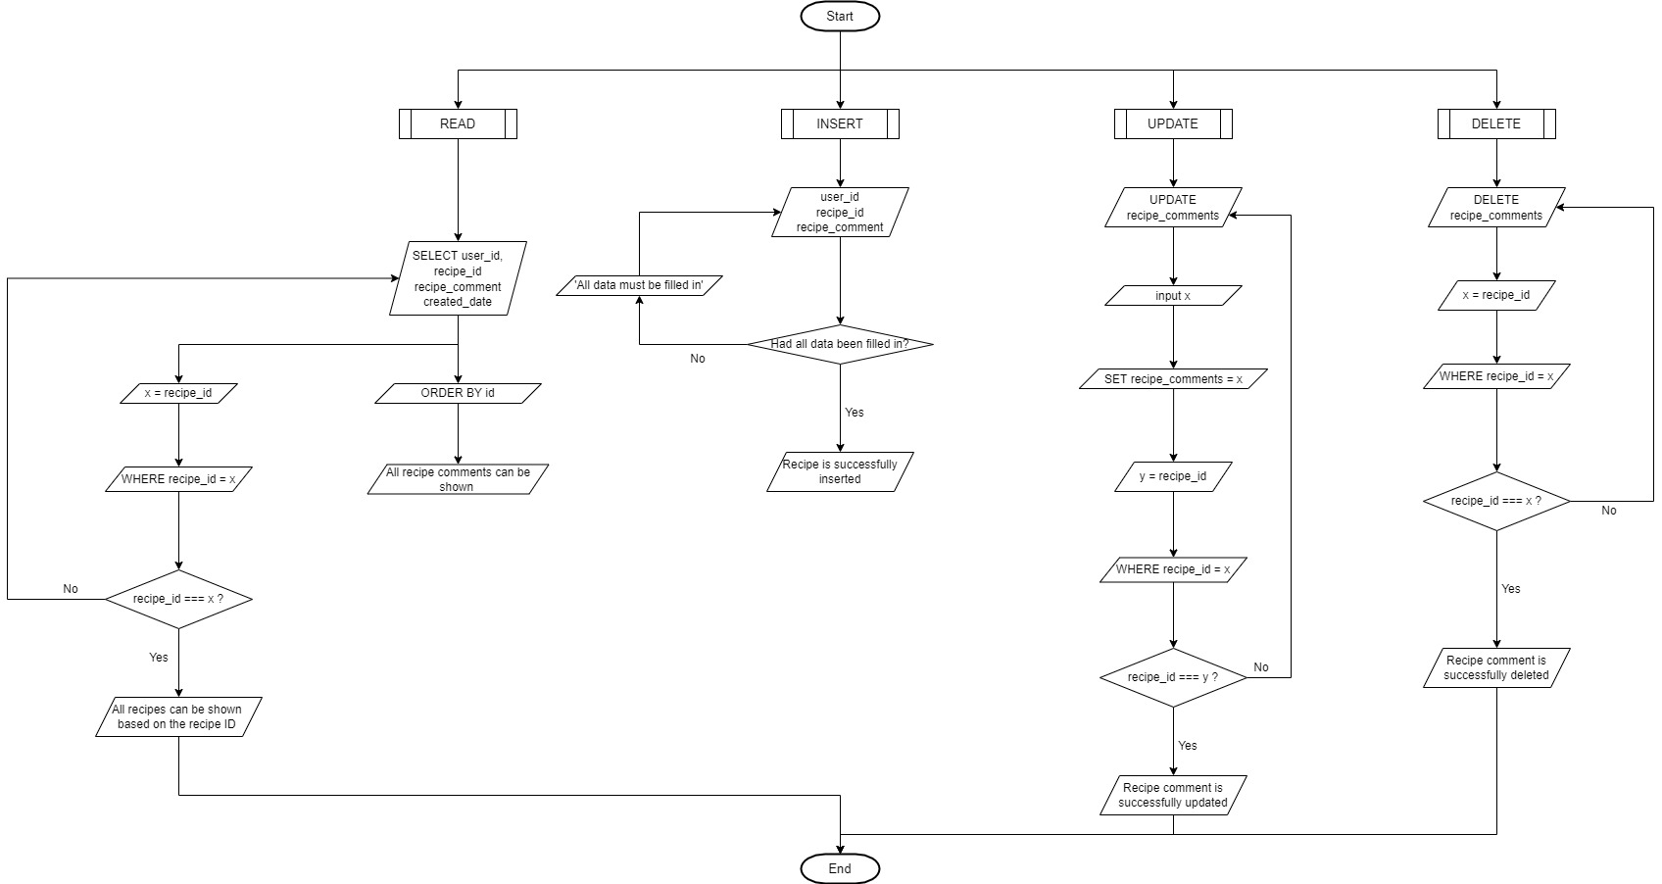
Recipe Comment CRUD Flowchart

Slide 8
API Demo

Slide 9
Development Plan
User’s role for Eat, Cook, Repeat (User, Admin, Chef, etc.)
New data for some food categories and tastes, for more specific recipe data
Some great and special food categories in New Recipe menu (the latest recipes)
Database and tables for users in profile editing, recipe saving and recipe liking

Slide 10
Any Question Before Closing?

Slide 11
Thank You

